Slide 1
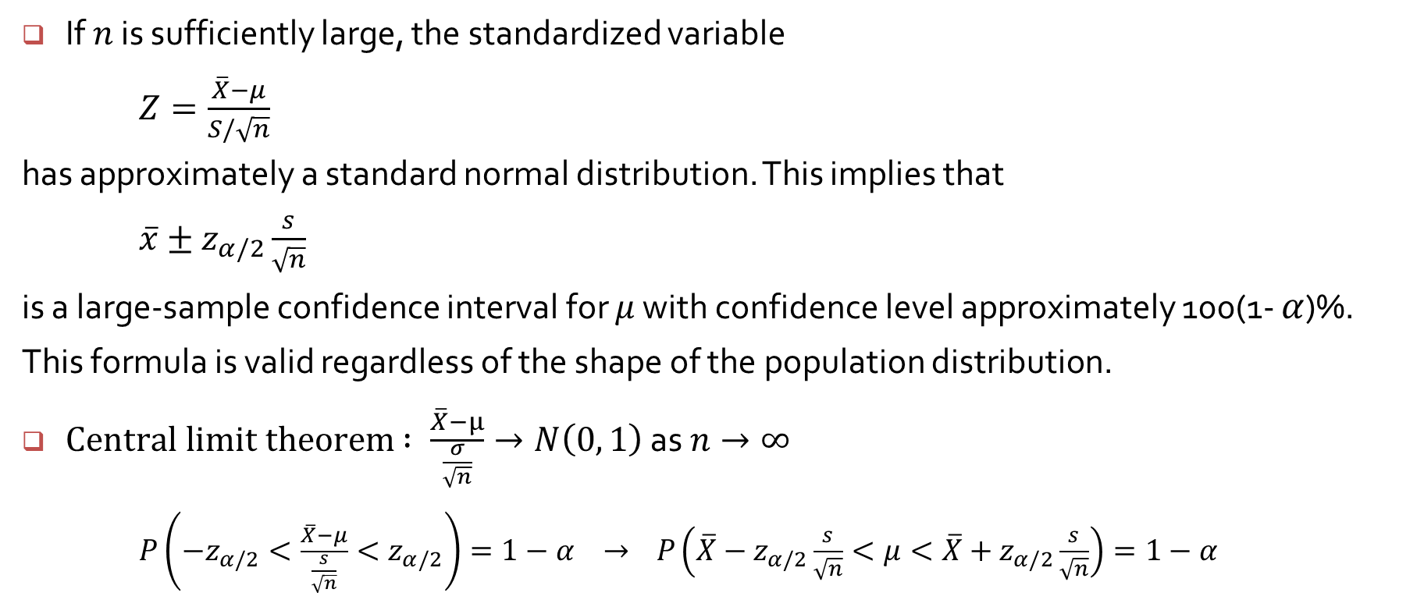
Large sample confidence interval when $σ$ unknown
If $n$ is sufficiently large, the standardized variable
$Z=\frac{\overline{X}−μ}{S/\sqrt{n}}$
has approximately a standard normal distribution. This implies that
$\overline{x}±z_{α/2}\frac{s}{\sqrt{n}}$
is a large-sample confidence interval for $μ$ with confidence level approximately 100(1- $α$)%.
This formula is valid regardless of the shape of the population distribution.
$Central limit theorem$ $: \frac{\overline{X}−μ}{\frac{σ}{\sqrt{n}}}→N\left(0, 1\right) \text{as} n→∞$
$P\left(−z_{α/2}<\frac{\overline{X}−μ}{\frac{s}{\sqrt{n}}}<z_{α/2}\right)=1−α →$ $P\left(\overline{X}−z_{α/2}\frac{s}{\sqrt{n}}<μ<\overline{X}+z_{α/2}\frac{s}{\sqrt{n}}\right)=1−α$

Slide 2
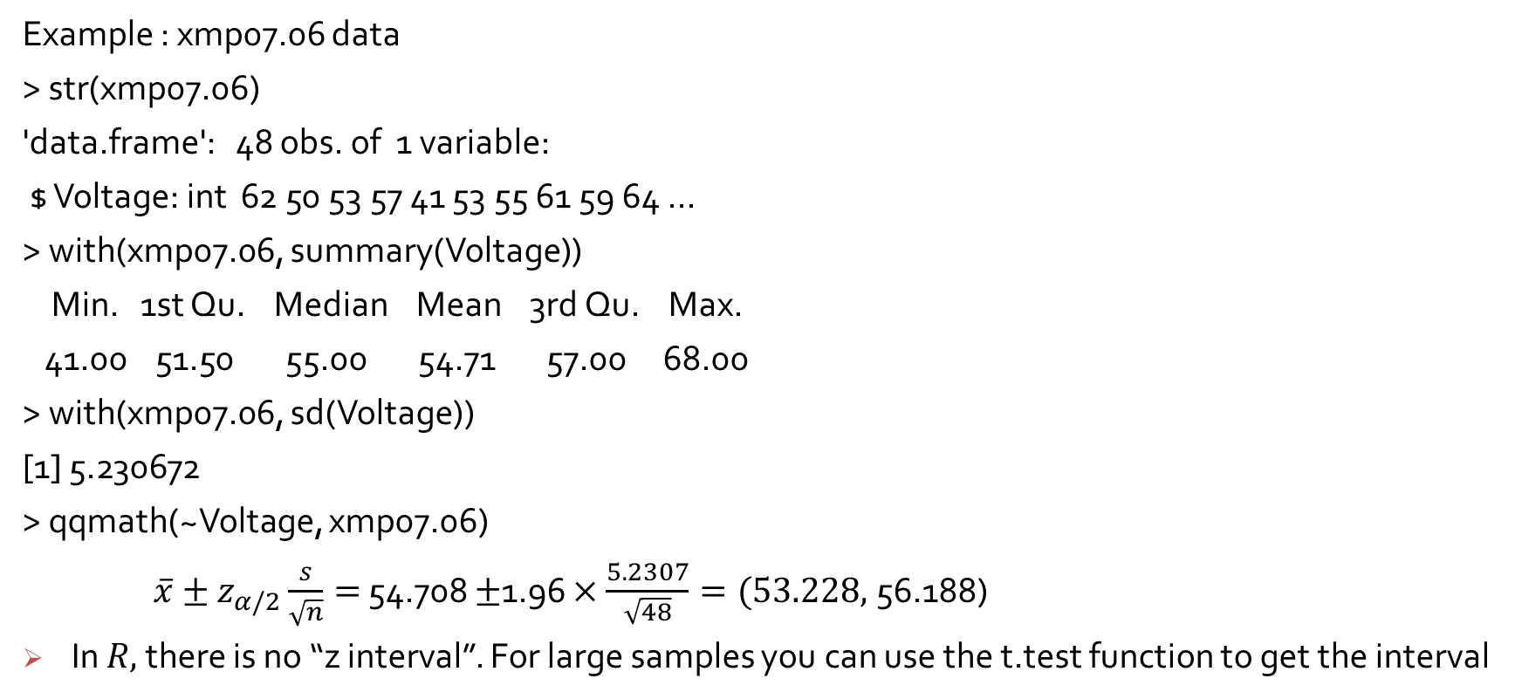
Large sample confidence interval
Example : xmp07.06 data
> str(xmp07.06)
'data.frame': 48 obs. of 1 variable:
$ Voltage: int 62 50 53 57 41 53 55 61 59 64 ...
> with(xmp07.06, summary(Voltage))
Min. 1st Qu. Median Mean 3rd Qu. Max.
41.00 51.50 55.00 54.71 57.00 68.00
> with(xmp07.06, sd(Voltage))
[1] 5.230672
> qqmath(~Voltage, xmp07.06)
$\overline{x}±z_{α/2}\frac{s}{\sqrt{n}}=$ 54.708 $±$1.96 $×\frac{5.2307}{\sqrt{48}}=(53.228,$56.188)
In $R,$ there is no “z interval”. For large samples you can use the t.test function to get the interval

Slide 3
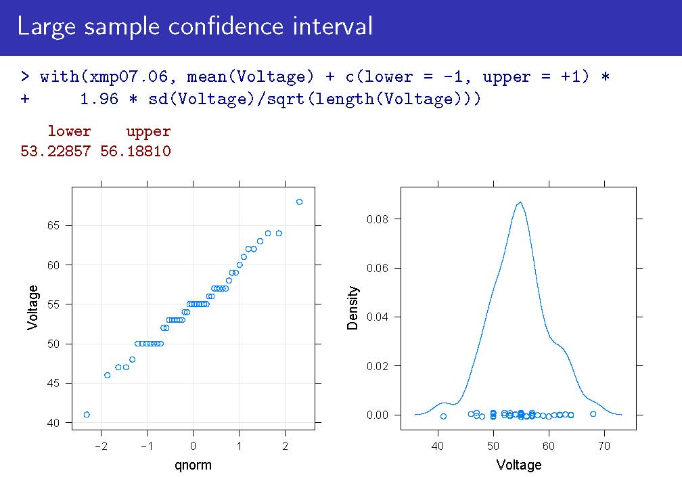

Slide 4
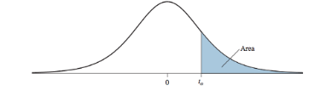
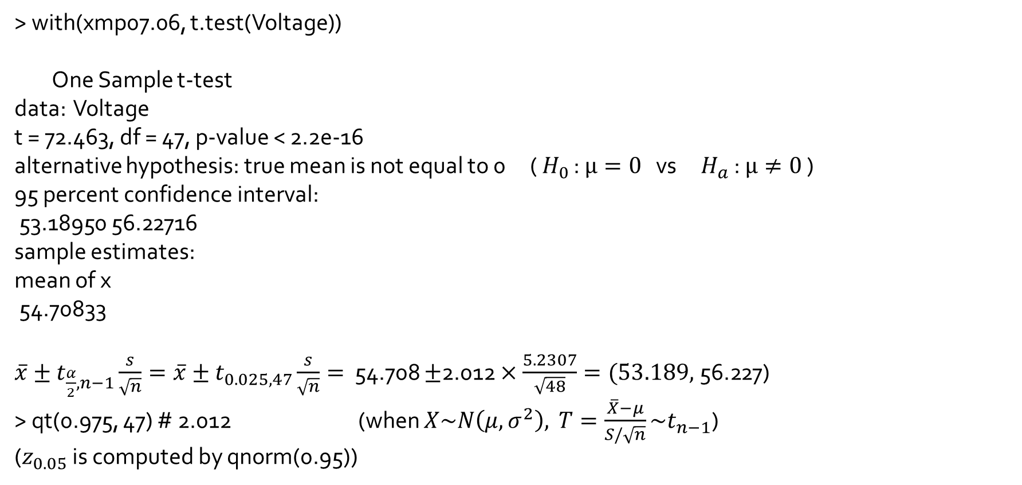
> with(xmp07.06, t.test(Voltage))
One Sample t-test
data: Voltage
t = 72.463, df = 47, p-value < 2.2e-16
alternative hypothesis: true mean is not equal to 0 ( $H_{0}$ : $μ=0$ vs $H_{a}$ : $μ≠0$ )
95 percent confidence interval:
53.18950 56.22716
sample estimates:
mean of x
54.70833
$\overline{x}±t_{\frac{α}{2},n−1}\frac{s}{\sqrt{n}}=\overline{x}±t_{0.025, 47}\frac{s}{\sqrt{n}}=$ 54.708 $±$2.012 $×\frac{5.2307}{\sqrt{48}}=(53.189,$56.227)
> qt(0.975, 47) # 2.012 (when $X\sim N\left(μ, σ^{2}\right),$ $T=\frac{\overline{X}−μ}{S/\sqrt{n}}\sim t_{n−1}$)
($z_{0.05}$ is computed by qnorm(0.95))

